Slide 1
SOFT COMPUTING
CNN Pruning Using Genetic Algorithms and Knowledge Distillation
Department of CSE (Artificial Intelligence and Machine Learning) · Chaitanya Bharathi Institute of Technology (CBIT), Hyderabad
BHEESHMA SHANKAR A · 160124748093

Slide 2
02 / JUSTIFICATION OF THE TITLE
CNNs are accurate but costly, so we compress them
PROBLEM
PRUNING
SEARCH
DISTILLATION
CNNs require substantial memory and computation.
Structured pruning removes selected channels.
Genetic Algorithms search for channel-pruning configurations.
Knowledge Distillation transfers useful knowledge from a larger teacher CNN to a smaller student CNN.
Teacher CNN →
GA-Based Channel Pruning →
Knowledge Distillation →
Compressed Student CNN
Notes:
The title is justified by this chain: prune channels with a GA search, then recover accuracy by distilling the teacher into the smaller student.

Slide 3


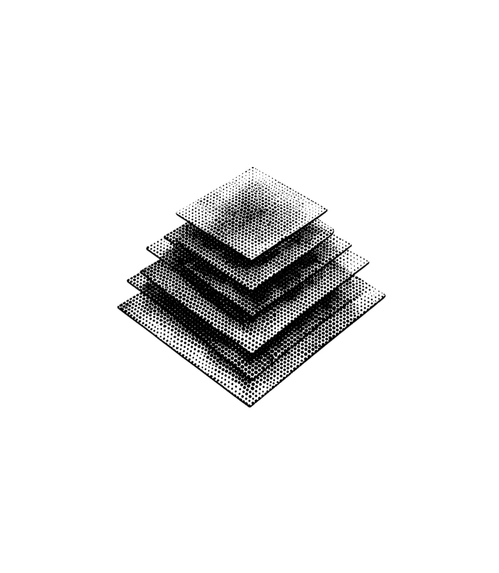


03 / MAIN OBJECTIVE
Reduce CNN complexity while maintaining classification accuracy
PARAMETER EFFICIENCY
COMPUTATIONAL EFFICIENCY
Reduce model parameters
Reduce MACs
Fewer weights to store and load.
Fewer multiply-accumulate operations per image.
Reduce trainable weights and model memory.
Reduce MACs and FLOPs.
ACCURACY PRESERVATION
DEPLOYMENT MEASUREMENT
Preserve classification performance
Measure inference latency
Speed is measured on hardware, not assumed.
Test accuracy stays close to the teacher.
Keep student performance close to the teacher using Knowledge Distillation.
Compare inference latency on the same hardware.
Success = a smaller model, nearly unchanged accuracy, and an honest measurement of real-world speed.
Notes:
State the goal first: a smaller CNN that keeps its accuracy. Then walk the four areas: parameters, MACs and FLOPs, accuracy via Knowledge Distillation, and latency measured on the same hardware. Close on the success line.

Slide 4


04 / PURPOSE AND MOTIVATION
ORIGINAL CNN
PRUNED CNN
Why CNN compression matters for efficient deployment
Large model that needs more memory, computation, and resources.
Memory use · Computation · Energy demand · Deployment difficulty
Structured pruning removes selected channels and reduces complexity; Knowledge Distillation may preserve accuracy.
Whole channels create a smaller dense network; the student learns from the teacher after compression.
Large models require more memory and computation for deployment.
Structured pruning reduces complexity by removing whole channels.
Knowledge Distillation may preserve accuracy in the smaller student.
CAUTION
Lower MACs do not automatically guarantee lower latency.
Fewer operations do not automatically mean faster inference; latency must be measured.
WHY THIS MATTERS
Mobile, embedded, and edge devices
Notes:
Compression targets deployment cost. Remind the audience that fewer FLOPs do not guarantee lower latency.

Slide 5










05 / DATASET
TOTAL
CIFAR-10: 60,000 colour images in 10 classes
60,000
Each image is 32×32 pixels, split into training, validation, and test sets.
ROLE IN THIS STUDY
Training 75%
8%
Test 17%
Train the teacher
Evaluate the pruned student
Compare accuracy and efficiency metrics
TRAINING
VALIDATION
TESTING
45,000
5,000
10,000
Airplane
Automobile
Bird
Cat
Deer
Dog
Frog
Horse
Ship
Truck
Notes:
CIFAR-10 has 60,000 colour images of 32×32 pixels in 10 classes. The split is 45,000 for training, 5,000 for validation and 10,000 for testing. The same dataset trains the teacher, evaluates the pruned student, and supports the accuracy and efficiency comparison.

Slide 6
06 / PROPOSED METHODOLOGY
Teacher training, GA pruning, then distillation
CIFAR-10 preparation
→
Original CNN teacher training
→
GA search for channel-pruning ratios
Pruned student construction
→
Knowledge-distillation retraining
→
Evaluation
GENETIC ALGORITHM
KNOWLEDGE DISTILLATION
Searches per-layer channel-pruning ratios using channel importance and fitness.
The pruned student learns from the teacher’s softened outputs and the labels.
METRICS: ACCURACY, PRECISION, RECALL, F1-SCORE, PARAMETERS, MACS, FLOPS, LATENCY.
Notes:
Keep the GA and KD explanations short; the detail follows on the implementation slide.

Slide 7
07 / IMPLEMENTATION
Implementation on CIFAR-10 with a Tesla T4 GPU
ENVIRONMENT
BASELINE CNN
TRAINING
Python · PyTorch · Google Colab · NVIDIA Tesla T4 GPU
Conv layers with 32, 64, and 128 channels, then a 256-neuron fully connected layer.
Teacher: original CNN. Student: GA-pruned CNN. 8 epochs · temperature 4 · α 0.7 · AdamW.
DATASET
CIFAR-10: 60,000 images, 10 classes.
GA BEST PRUNING RATIOS
GENETIC ALGORITHM
CONV1
CONV2
CONV3
Searches channel-pruning ratios using channel importance and fitness evaluation.
0.095
0.000
0.260
WORKFLOW
CIFAR-10 → Baseline CNN → Channel Importance → Genetic Algorithm → Structured Pruning → Knowledge Distillation → Optimized CNN
Notes:
The GA-pruned student keeps the teacher’s training recipe but removes channels in conv1 and conv3; conv2 is left unpruned.

Slide 8
08 / RESULTS AND PERFORMANCE ANALYSIS
Teacher vs GA-pruned student: 26% fewer parameters
Metric | Teacher CNN | GA-Pruned CNN + KD | Change
Test accuracy | 79.33% | 79.00% | −0.33 pp
Macro F1-score | 0.7927 | 0.7899 | −0.0028
Parameters | 620,810 | 459,436 | −25.99%
MACs | 10.8488 M | 8.7557 M | −19.29%
FLOPs | 21.6975 M | 17.5114 M | −19.29%
Latency | 1.3488 ms | 1.6645 ms | +23.41%
PARAMETER REDUCTION
MAC AND FLOP REDUCTION
ACCURACY DECREASE
MEASURED LATENCY INCREASE
25.99%
0.33 pp
19.29%
23.41%
Genetic Algorithm-based structured pruning combined with Knowledge Distillation reduced model size and computational cost while preserving nearly the same classification accuracy; however, inference latency requires further optimization.
Notes:
Lead with the accuracy-versus-size trade-off, then state plainly that latency got worse.

Slide 9
09 / CONCLUSION AND FUTURE SCOPE
Completed work and proposed future work
COMPLETED
PROPOSED — NOT YET DONE
Conclusion
Future scope
Developed and evaluated the original CNN and the GA-pruned student
Reduced parameters by 25.99% and MACs by 19.29%
Retained 79.00% student accuracy vs 79.33% teacher
Observed a 23.41% increase in measured latency
Different pruning ratios and GA fitness functions
Compare uniform pruning, Taylor-based pruning, and KD-only models
Multiple random seeds
Additional architectures and datasets
CPU, GPU, and edge latency
Hardware-aware pruning
Notes:
Be explicit that the future list is proposed work, not results.

Slide 10
THANK YOU
Questions?
CNN Pruning Using Genetic Algorithms and Knowledge Distillation
BHEESHMA SHANKAR A | 160124748093 · CBIT | CSE (AI & ML)

